Slide 1
Flood - IT
“Where colors spread fast and smart choices matter more.”

Slide 2
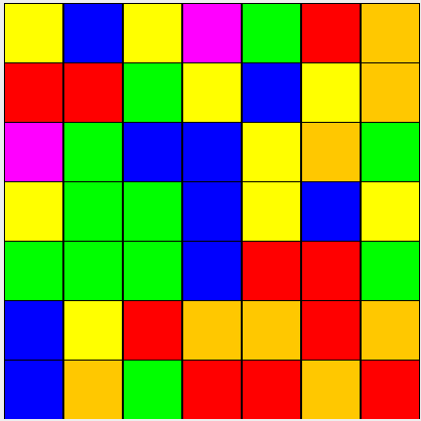
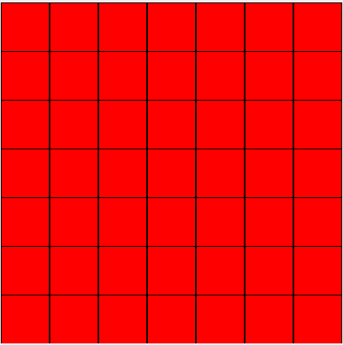
Main Goal and Rules to play.
Aim:-
Your goal is to fill the entire board with a single color in the fewest possible moves.
Rules to play:-
The game always starts from the top-left cell (0,0). Every move changes the color of this starting region spreads (floods) to all connected cells of the same color.

Slide 3
What is Backtracking?
Backtracking is an algorithmic technique used to solve problems by exploring possible solutions and abandoning paths that cannot lead to a valid solution.
Key Idea:
Choose a possible option
Explore further choices
If the solution becomes invalid or inefficient
Backtrack and try another option
Characteristics:
Uses Depth-First Search (DFS) strategy
Explores solution space step by step
Avoids unnecessary paths using pruning
Finds optimal or near-optimal solution

Slide 4
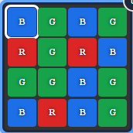
Backtracking in Flood-It Solver
In this project, Backtracking is used to find the best next color move.
Algorithm process:
Start from the current board state
Identify the possible colors that can expand the flooded region
Try each color as the next move
Simulate the result of choosing that color
Recursively explore future moves
Track the minimum number of moves needed to solve the board
Conditions:
Choose only the neighbouring color to expand the flood instead of exploring all solutions.
If the depth limit is more than 10 it stops computing.
If one path return a move count of 7 while other path return move count 6 then its chooses the minimum among them

Slide 5
Depth-First Search Strategy
The solver explores moves using a Depth-First Search strategy.
Search process:
Start with the current board
Try one possible color move
Move deeper by applying additional moves
Continue until:
The board is solved
Maximum search depth is reached
If a branch does not lead to a better solution, the algorithm backtracks and explores another color option.
This ensures the solver checks multiple possible strategies and selects the best move sequence.

Slide 6
What is Dynamic Programming?
Dynamic Programming (DP) is an algorithmic technique used to solve complex problems by breaking them into smaller subproblems.
Key Idea:
Solve each subproblem only once
Store the result in memory
Reuse the stored result when needed
Benefits of Dynamic Programming:
Avoids repeated calculations
Reduces computational time
Improves efficiency of recursive algorithms

Slide 7
Dynamic Programming in Flood-It Solver
Goal : Find the minimum number of moves to make the entire grid into a single color
Identify The subproblem : After simulating the particular color then again finding the minimum number of moves for the subproblem
Guess part of the solution
Goal: Decide the next choice you will try for the subproblem.
In Flood-It: the “guess” is the next color you will flood the current area with.
You don’t try all colors blindly — only the ones that actually expand the flooded area (neighbor colors).
Relate subproblems
Goal: Express the solution to the current subproblem in terms of smaller subproblems.
Flooding with a color gives a new board state.
The minimum moves for the current board = 1 (this move) + minimum moves for the new board:

Slide 8
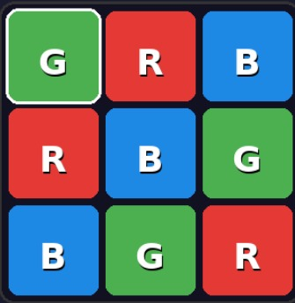
Recurse and solve the subproblem
You call solve(next) recursively for each possible move.
Base case: when the board is already solved (all cells same color):
Memoization
Goal: Store results of subproblems so you don’t recompute them.

Slide 9
Memoization and Cache Storage
Memoization is used to store previously solved board states.
In the program, a HashMap cache is used:
Key → Encoded board state Value → Minimum number of moves required to solve it
Steps:
Convert the board into a unique encoded value
Check if the encoded state exists in the cache
If found, reuse the stored result
If not, compute the result and store it in the cache
This prevents repeated calculations and makes the solver much faster.

Slide 10
Why Top-Down DP Instead of Bottom-Up in Flood-It Solver
1. Huge Number of Possible Board States
Flood-It board changes after every move.
Possible states grow exponentially.
Example: 6 × 6 board with 6 colors → 6³⁶ possible states.
2. Bottom-Up DP is Impractical
Bottom-Up must compute all possible states first.
Requires extremely large time and memory.
Not feasible for Flood-It.
3. Top-Down DP with Memoization is Efficient
Computes only the states that actually occur during solving.
Stores results in a DP cache (HashMap).
Avoids recomputing the same board state.
4. Fits the Recursive Nature of the Game
Each move creates a new board state.
Recursively explore moves and store optimal results.

